Slide 1



Housing Price & Salary
Shum Chang Wu Chen (Willy) Yucheng Chen Alex Moronta Jubayeth Mian

Slide 2

Goal
Importance
To determine if properties are within budget range based on average salaries from various professions within the NY county.
This will allow users to identify the ideal location to look for properties based on expected salary within their profession.
Notes:
The goal for today is to see which county is a reasonable option for us to pursue to looking at a property

Slide 3
Business Requirements
The most important factors for our users are: Salary & Housing Price Range
Dashboard showing measures that fall into the desired price range, location, etc.

Slide 4
Functional Requirements
Business Intelligence Usage Generate tables with relevant information for report & and graphs for trends/pattern inferences.
Detailed Analytics Generating refined data columns for statistical purposes such as regression models & correlation analysis.

Slide 5
Data Requirements
Geographical Coverage Data on properties will cover those in NY, NJ, CT and PA.
Processing String values for keys must be as consistent and standardized as possible across all tables. Null values in required fields should be filtered out.
Pipeline Data should be stored in one central warehouse (Snowflake).

Slide 6
Regulatory Requirements
User Privacy Seller and buyer information should not be shown or used.
Data Sourcing All information must only be sourced from publicly accessible locations to avoid confidential business info from being leaked.

Slide 7
Business Personas
Homebuyers Looking to for relocation options near New York or first time house.
Real Estate Agents Information gathering for their operating region/area.
Data Scientists To determine variable impacts on price

Slide 8
Benefits
Costs
Identifying pricing trends over the a time period.
Monetization of database for purpose of developing real estate apps & services.
Allows the integration of future housing data in other regions.
Server upkeep and usage costs
Time investment to develop and create the data pipeline and its BI uses.
Opportunity cost in resources spent

Slide 9
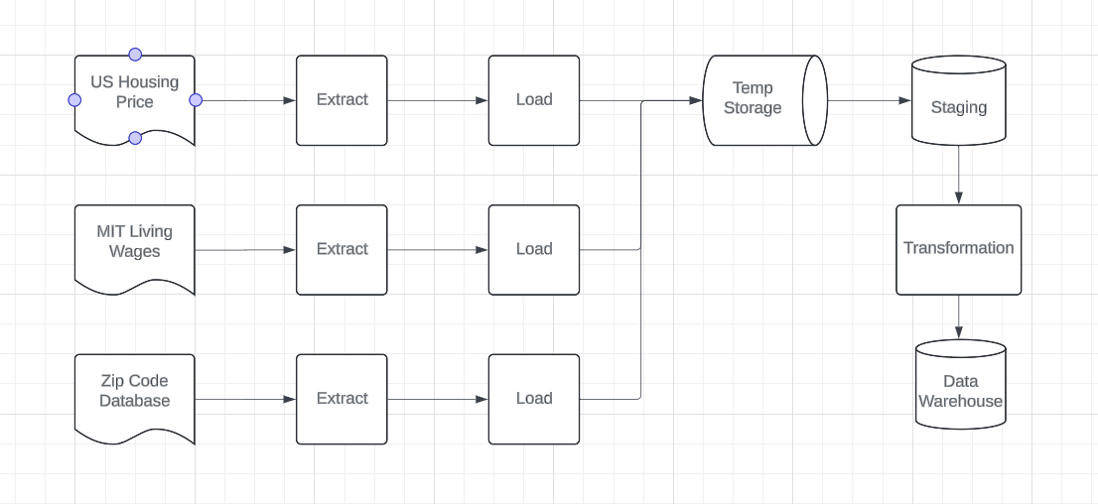
Information Architecture

Slide 10
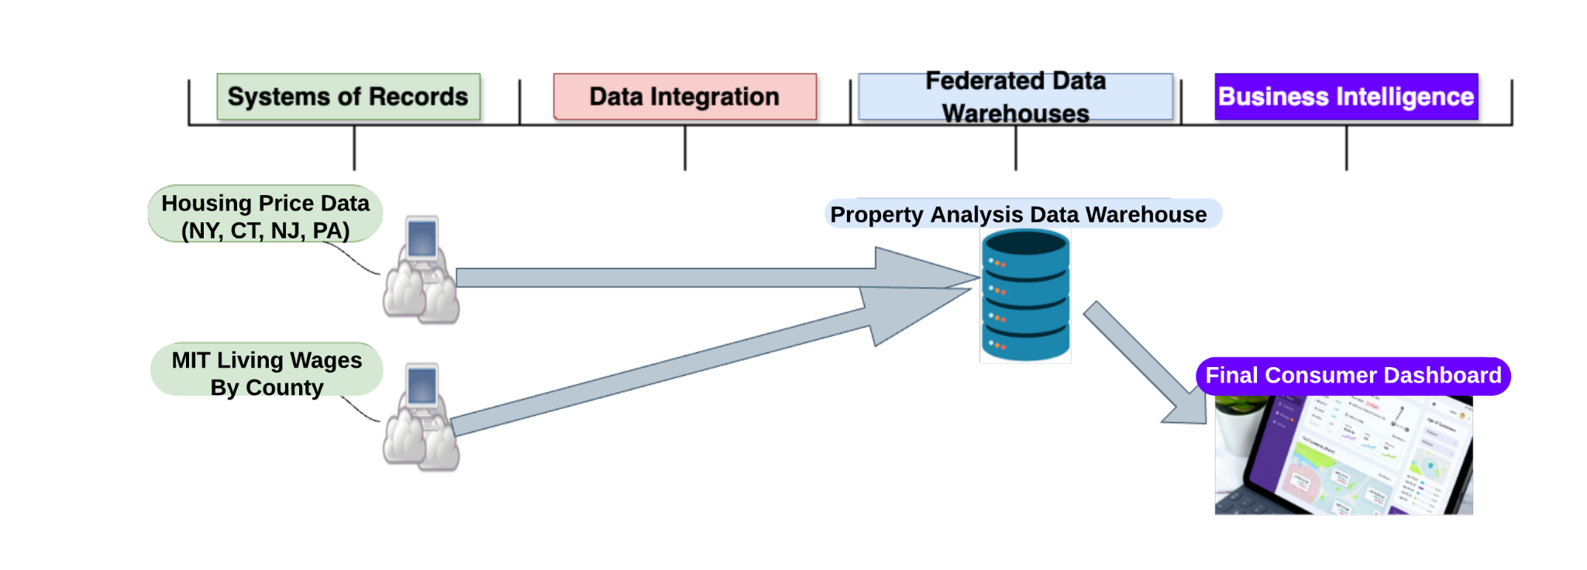
Data Architecture

Slide 11
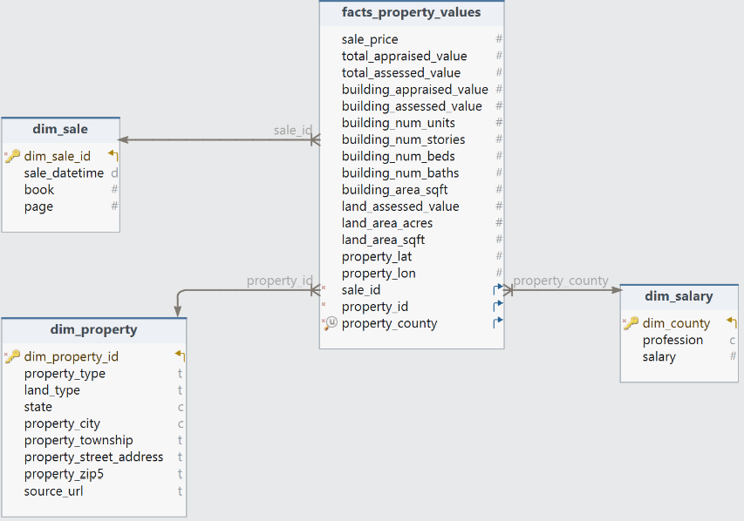
Dimensional Modeling

Slide 12
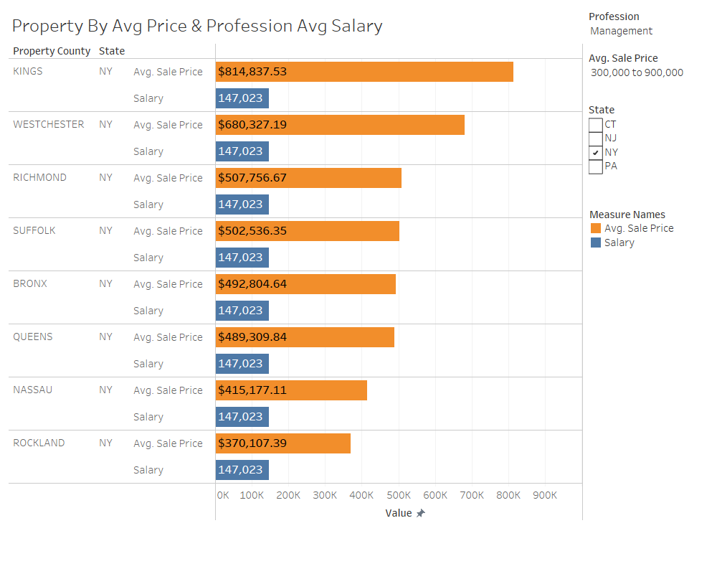

Slide 13
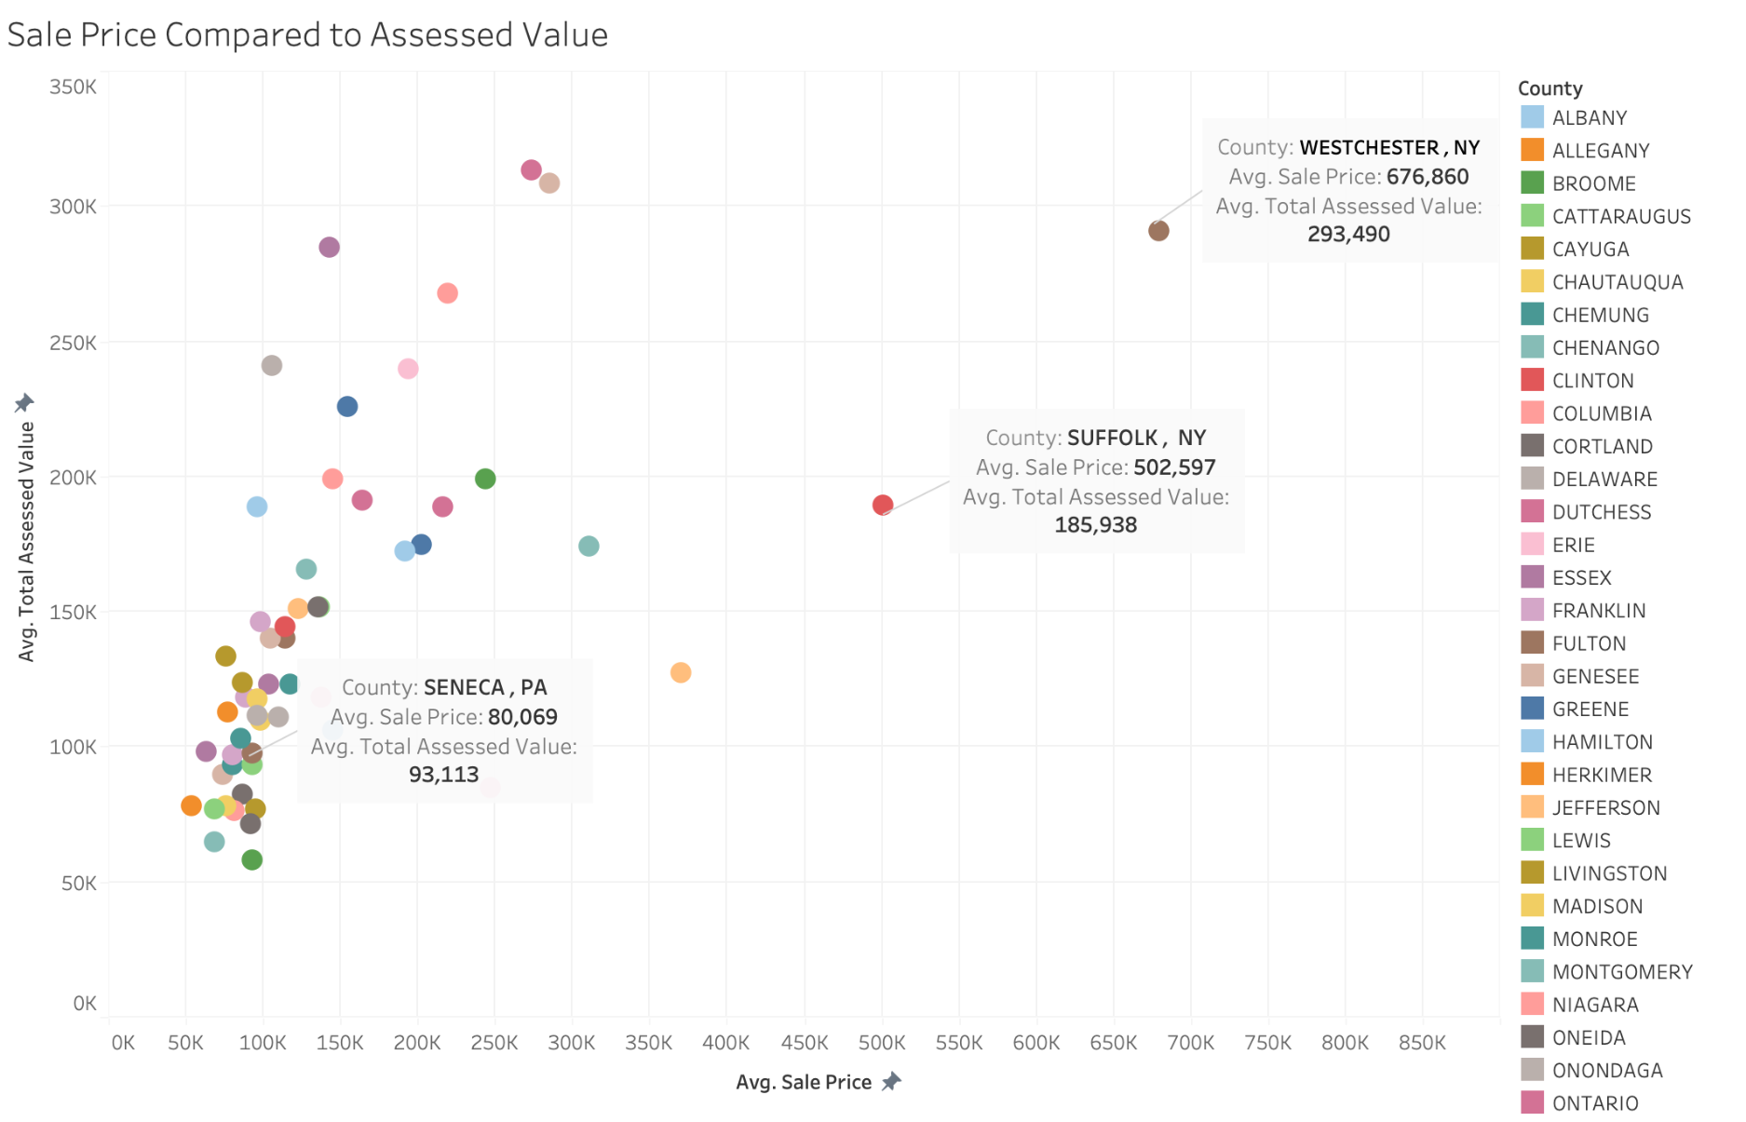
Notes:
Sale Price to Assessed Value: West Chester, NY is 230% more Suffolk, NY is 270% more Seneca, PA is only 86%!

Slide 14
Conclusion
Houses in the New York City area and its neighboring counties are extremely expensive.
Affordability by professions: Management, Computer Mathematics, Business & Financial Operations, Legal, Healthcare Practitioners, Technical & Architecture & Engineering

Slide 15
Future Work
Expand our data warehouse with the following data:
States outside of the four we covered
Cost of living data.
More comprehensive salary data and perhaps mortgage data.
Housing metrics such as number of bedrooms, bathrooms, backyard, etc.

Slide 16
Members Contribution
Shum Chang Wu Chen (Willy)
Information Architecture
Data extracting (NY)
Azure & Snowflake
Yucheng Chen
Data extracting (NJ)
Dimensional Modeling
Snowflake & DBT
Alex Moronta
Data Architecture
Data extracting (PA)
Data Visualization
Jubayeth Mian
Data extracting (PA)
Presentation

Slide 17


Thank You!
I hope you can find your dream home one day.
Notes:
My message to you, I hope you can make enough money to buy your dream home.

